Slide 1
Talent and Succession Management
Mr. John H. James, Jr.
Executive Director
Missile Defense Agency

Slide 2
Talent and Succession Management Process
Create transparency of existing talent in the career SES Corps to meet mission requirements;
Diagnose individual Executive development needs to prepare Executives to excel and meet career goals
Develop bench strength for Tier 2/3 SES positions and create baseline succession plans for critical positions;
Identify where resources should be directed to fill talent gaps and
Create a capability to standardize executive records and share talent across the Department

Slide 3
Purpose of the Planning Process
DoD considers our SES workforce to be an institutional asset. Our talent management and succession planning process is designed to:
  Ensure DoD complies with the requirement to “assess the critical skills, competencies, and gaps” within our executive workforce and 5 CFR 412 requirement to “develop specific procedures and accountability measures to ensure that executives are continually being developed”
  Develop succession plans for key civilian leadership positions
  Allow executives to express preferences for utilization and development
  Match executives to developmental opportunities to meet current and future requirements
  Inform strategic planning for our senior executive workforce

Slide 4
4Th Estate
Executive Development Framework
Entry to SES Meets Baseline ECQs – Mastery Requires Continuous Development
Leadership/Leading Change/Leading People
Strategic Thinking/Team Work
*OPM SES Newcomers Orientation
*APEX
*FEI SES Horizons Series
* Executive Summit
*Inside Congress
*Leading Edge
*DoD Executive Coaching
Enterprise Perspective/Joint & National Security
Business Acumen/Results Driven
Tier 1
*CAPSTONE
*SJIOAC
*JFOWC
*CYBER Ops
*NDU CFO Certificate Program
*Leadership for a Democratic Society
*Aspen Institute Seminar
*CAPSTONE
*Leading Edge
* Brooking Institute Leadership Lab
Functional Development (All Tiers)
Financial
Management
Acquisition
Information
Technology
Human Capital
Management
Others
*Coaching/360 Degree Assessment
*Harvard Senior Fellow Program
*Vanguard
*Leading Edge
*E- Cornell Leadership and Strategic Management
*MIT Transforming Your Leadership Strategic
*Harvard Strategic IQ
Tier 2
*CAPSTONE
*SJIOAC
*CYBER ops
*JFOWC
*Seminar XX1
*Harvard Finance for Senior Executives
*Harvard Negotiation & Leadership
*UNC Kenan Flager –Financial Crs for Non-Financial Analysis
*360 Degree Assessment *Leadership at the Peak(or equivalent)
*Vanguard
*Leading Edge
*MIT Managing Technical Professionals and Organizations *Harvard Leadership Best Practices
*Columbia University Leading Strategic Growth and Change
Tier 3
*CYBER Ops
*American Management Association (Advanced Executive Leadership Program)
*CYBER Ops
*Leadership Best Practices
*American Mgmt Assoc Seminar
* Not Centrally Funded

Slide 5
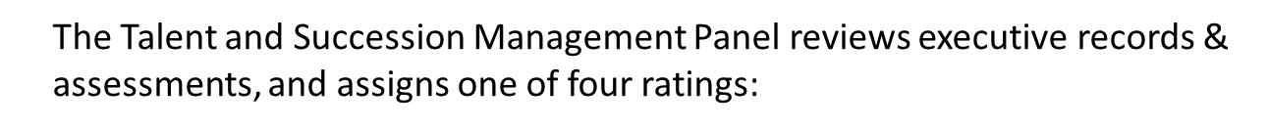
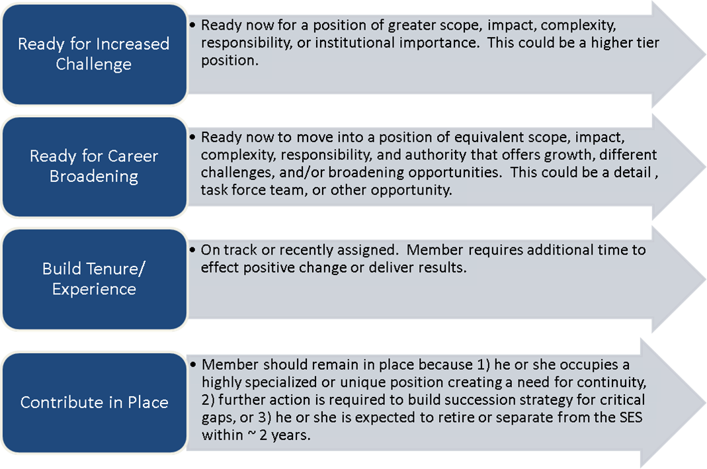
READINESS RATINGS

Slide 6
Panel Recommendations – Contribute in Place
After careful review and discussion of the data you provided in the Defense Talent Management System (DTMS) the following recommendations are provided:
It is clear that you are an extraordinarily talented executive possessing a wealth of technical expertise in the net assessment field, and are also highly regarded for your leadership of people and building of coalitions. In order to complete mission requirements, leadership requires your assistance for another year. The Panel recommends a readiness rating of Contribute in Place.
The Panel encourages you to offer your expertise by serving as a mentor to other Executives or personnel with less experience.
Upon completion of your current assignment, the Panel recommends you consider positions at the Director level that will allow you to use your skills specific to the Defense Technical Information Center (DTIC).

Slide 7
Panel Recommendations - Ready for Increased Challenge
After careful review and discussion of the data you provided in the Defense Talent Management System (DTMS) the following recommendations are provided:
Your portfolio is clearly extraordinary, and your ability to assume greater responsibility is exemplary. The Panel recommends a readiness rating of Ready for Increased Challenge.
The Panel believes you would benefit from participation in a 360 Degree Assessment and the Vanguard training program.
The Panel notes the positions you included in your career plans demonstrate thoughtful interest in your future. The Panel recommends that you create an Executive Development Plan that will help you leverage your experience and perspective in competing for these types of future opportunities. Your career plan should include paying courtesy calls on the Executives in the organizations that you have expressed an interest in. This should alert the organization of your interest and put you on their list for rotational or short term assignment opportunities. You are also encouraged to sign-on to the DTMS website and review the positions you are slated for under the Executive Profile, Section XVIII.

Slide 8
Panel Recommendations – Ready for Career Broadening
After careful review and discussion of the data you provided in the Defense Talent Management System (DTMS) the following recommendations are provided:
The Panel recommends a readiness rating of Ready for Career Broadening based on your documented skills in dealing with senior leadership, your ability to bridge theory to practice, and your track record in product delivery as a member of the OSD Staff, with the Navy, and in industry. All bode well for your professional future.
The Panel notes no recent Executive-level training reflected in your résumé. The Panel recommends you assess your training portfolio and seek training that will round out your career development portfolio. The Panel recommends you include in your training plan a 360 Degree Assessment. The executive services division in DA&M can assist in developing a training portfolio.
The Panel and your Rater believe that both your interests and those of the 4th Estate would be well-served by you seeking broader Executive Leadership opportunities. We suggest you look at several emerging focus areas such as Cybersecurity, Space, and Irregular Warfare for continued career growth. The Panel recommends you work with a DoD mentor to develop a five year Executive Development Plan that leverages your extensive technical and management experience to improve your competitiveness for Executive positions of increasing scope and responsibility.

Slide 9
Panel Recommendations – Build Tenure/Experience
After careful review and discussion of the data you provided in the Defense Talent Management System (DTMS) the following recommendations are provided:
Your résumé reflects an excellent portfolio of increasingly challenging positions, education, and training experiences. The Panel recommends a readiness rating of Build Tenure and Experience since have been in your current position for less than two years.
The Panel also notes your attendance at the Harvard Senior Executive Fellows course, and encourages your continued participation in future developmental opportunities such as the Joint Executive Management (JEM) Program.
The Panel notes your career plan includes positions that continue to focus on the experience you have obtained building up to and including your Executive tenure. Although the Panel recommends you remain in your current position to continue to gain your footing and effect change, to best position you for selected future assignments the Panel recommends that you work with a DoD mentor to prepare an Executive Development Plan for the next five years that will provide you the necessary experience to compete favorably.

Slide 10
Executive Self-Assessment
Executives provide information regarding previous experiences, assess themselves on the 18 DoD core competencies, and provide succession management data for their current positions. They also develop a career plan identifying near-term, mid-term, and long-term proposed positions of interest.
Benefits of the Self Assessment:
Provides executives the ability to influence their future
Allows executives input into the succession management plan for their current position
Provides executives with the opportunity to assess their competencies and identify strengths and weaknesses
Allow executives to map out their career path

Slide 11
Supervisory/Rater Assessment
The supervisor/rater is responsible for providing a readiness rating and competency assessment for the executives within his/her chain of command.
Provides supervisors/raters with the opportunity to help influence their employee’s future
Allows supervisors/raters the opportunity to assess their employees’ competencies and identify developmental opportunities
Provides supervisors/raters with the opportunity to help map out options for an employee’s career path

Slide 12
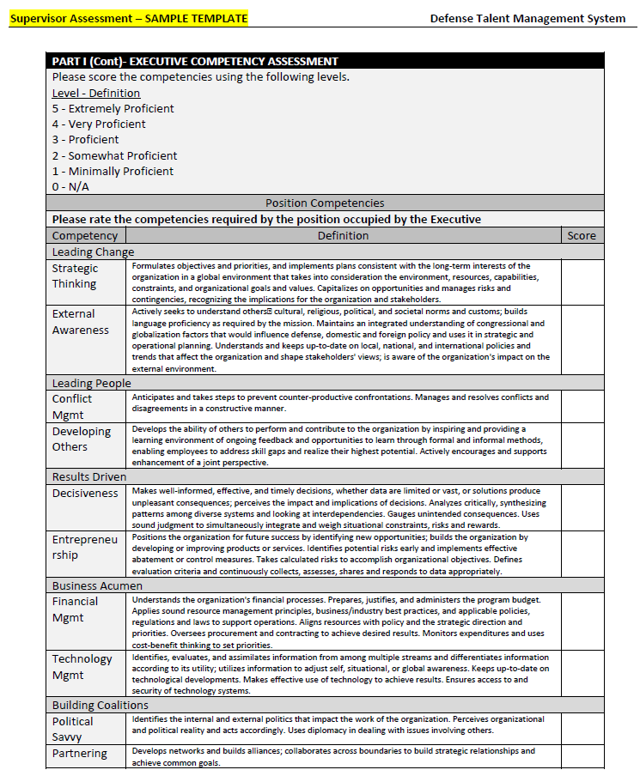
Supervisor Assessment

Slide 13
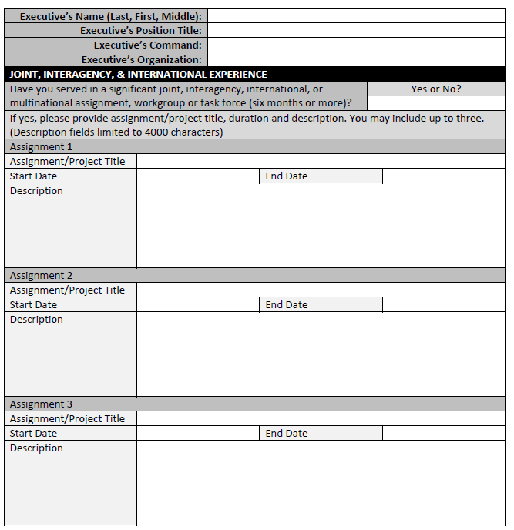
Executive Self-Assessment

Slide 14
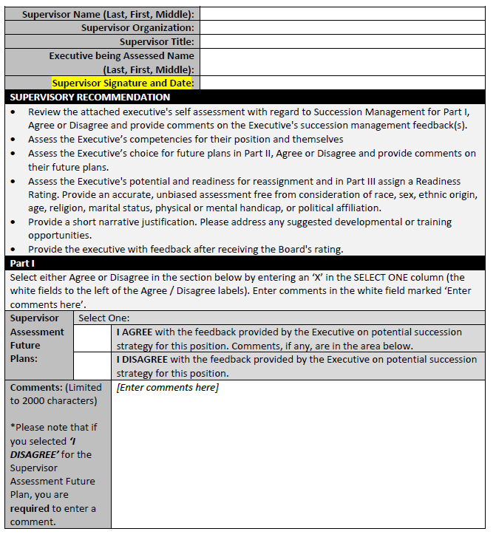
Supervisor Assessment

Slide 15


Slide 16
BACKUP

Slide 17
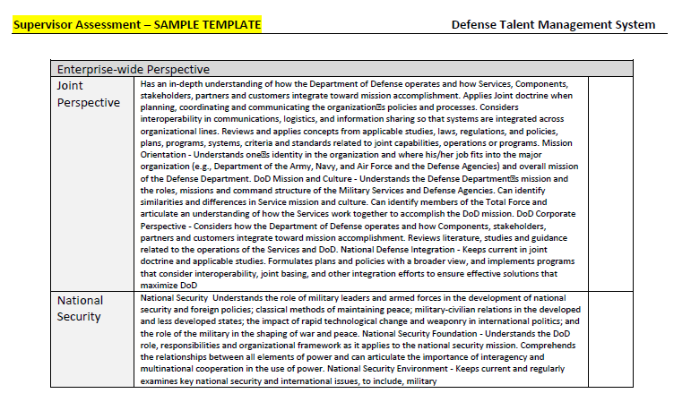
Supervisor Assessment

Slide 18
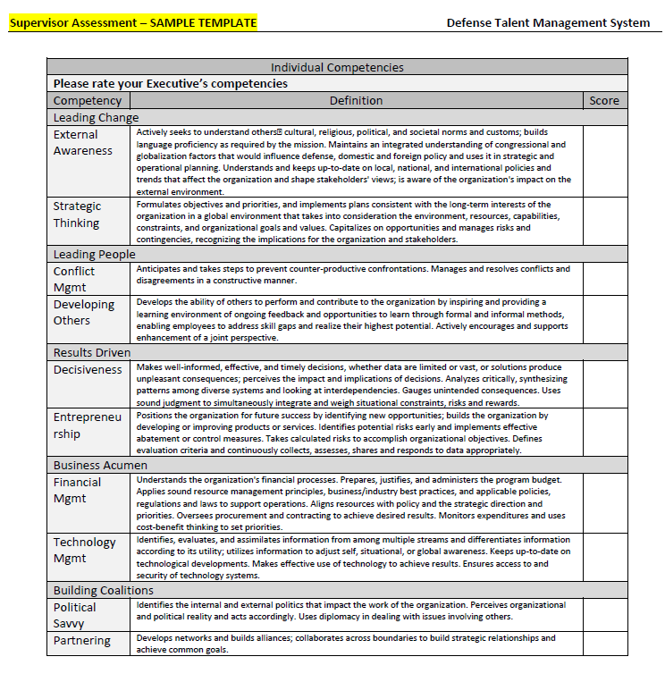
Supervisor Assessment

Slide 19
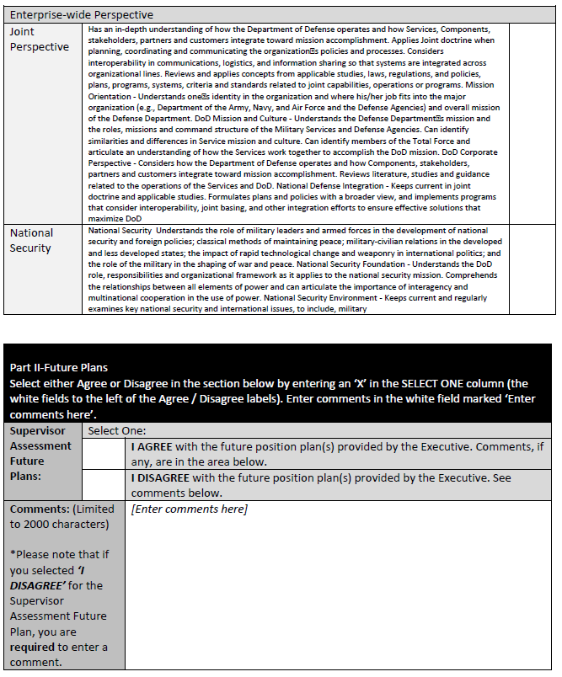
Supervisor Assessment

Slide 20
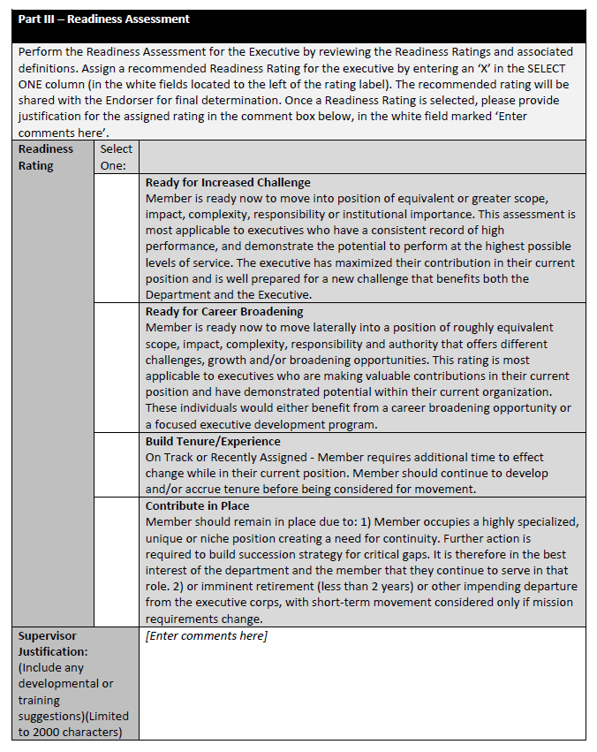
Supervisor Assessment

Slide 21
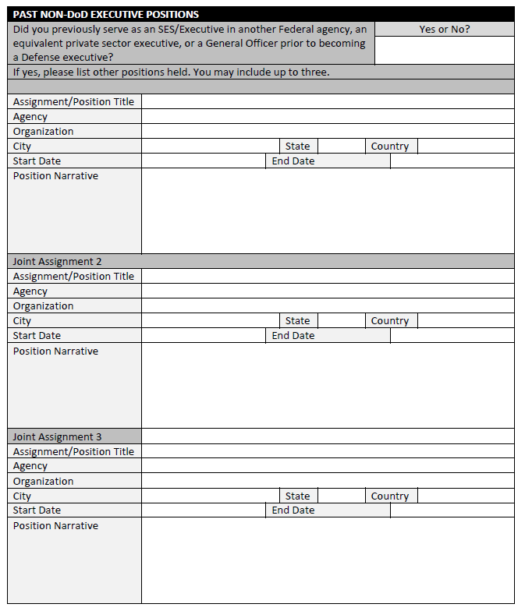
Executive Self-Assessment

Slide 22
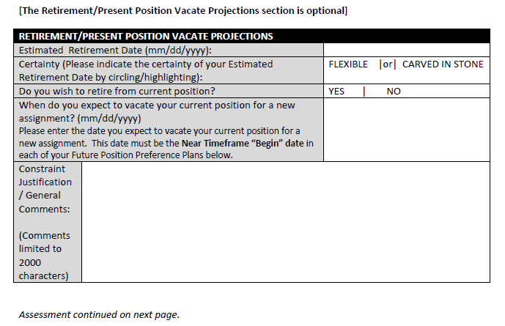
Executive Self-Assessment

Slide 23
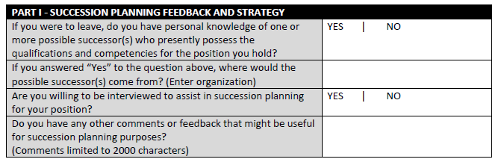
Executive Self-Assessment

Slide 24
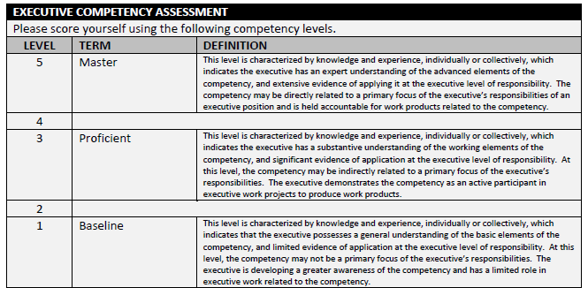
Executive Self-Assessment

Slide 25
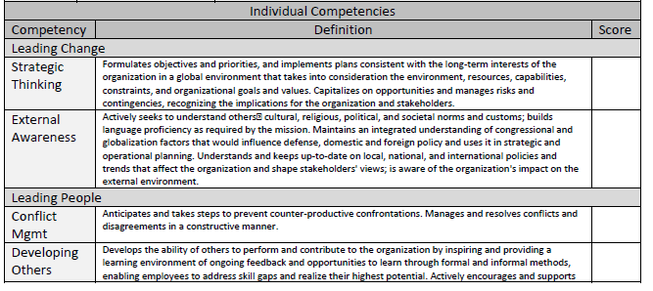
Executive Self-Assessment

Slide 26
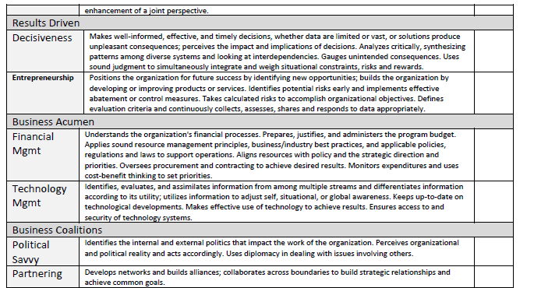
Executive Self-Assessment

Slide 27
Executive Self-Assessment

Slide 28
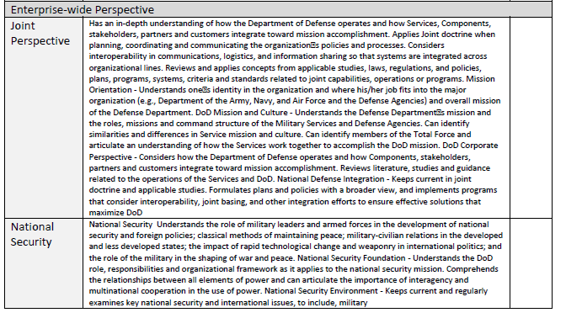
Executive Self-Assessment

Slide 29
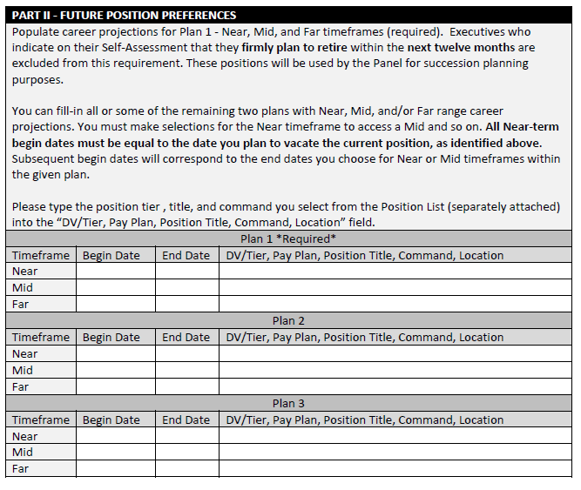
Executive Self-Assessment

